Slide 1
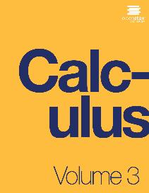

CALCULUS volUME 3
Chapter 2 VECTORS IN SPACE
PowerPoint Image Slideshow

Slide 2

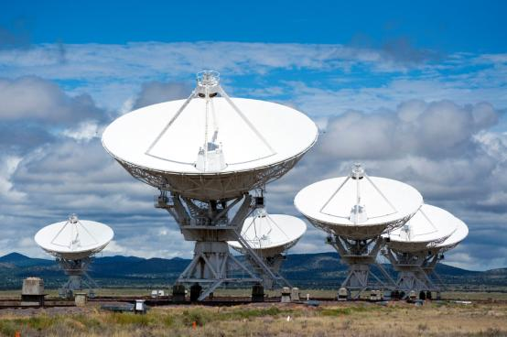
Figure 2.1
The Karl G. Jansky Very Large Array, located in Socorro, New Mexico, consists of a large number of radio telescopes that can collect radio waves and collate them as if they were gathering waves over a huge area with no gaps in coverage. (credit: modification of work by CGP Grey, Wikimedia Commons)

Slide 3
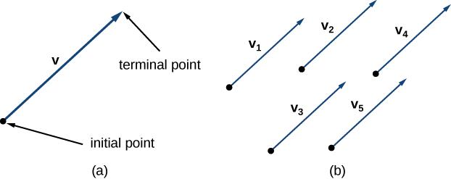
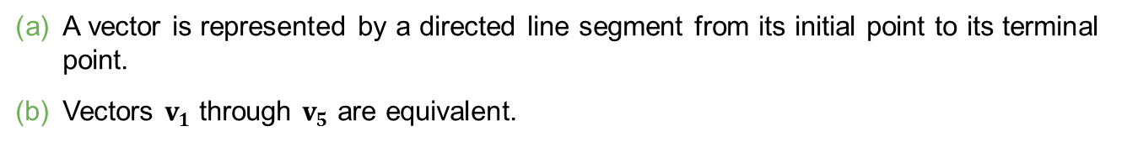
Figure 2.2
A vector is represented by a directed line segment from its initial point to its terminal point.
Vectors $v_{1}$ through $v_{5}$ are equivalent.

Slide 4
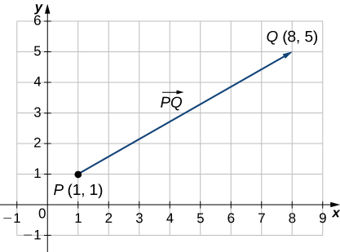
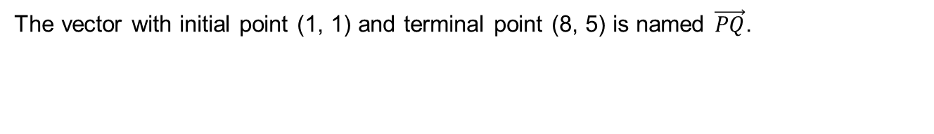
Figure 2.3
The vector with initial point (1, 1) and terminal point (8, 5) is named $\vec{PQ}$.

Slide 5
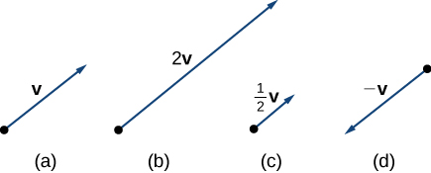
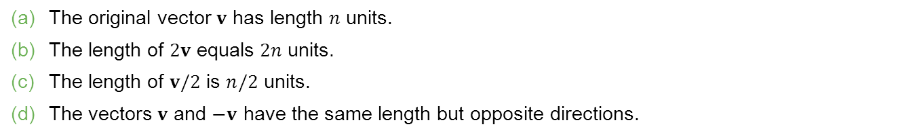
Figure 2.4
The original vector $v$ has length $n$ units.
The length of $2v$ equals $2n$ units.
The length of $v/2$ is $n/2$ units.
The vectors $v$ and $−v$ have the same length but opposite directions.

Slide 6
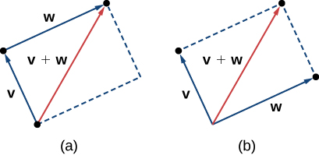
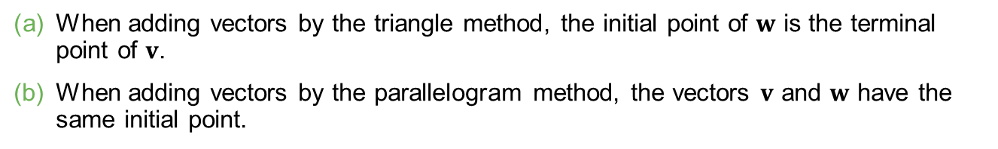
Figure 2.5
When adding vectors by the triangle method, the initial point of $w$ is the terminal point of $v$.
When adding vectors by the parallelogram method, the vectors $v$ and $w$ have the same initial point.

Slide 7
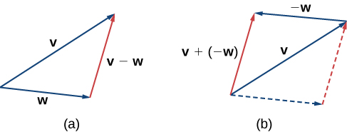
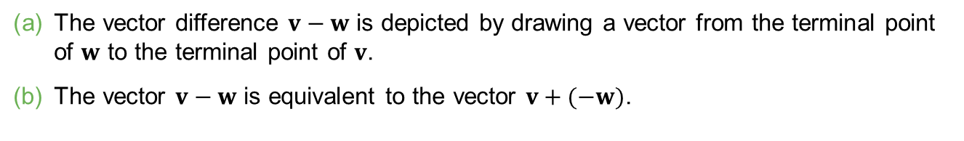
Figure 2.6
The vector difference $v−w$ is depicted by drawing a vector from the terminal point of $w$ to the terminal point of $v$.
The vector $v−w$ is equivalent to the vector $v+(−w)$.

Slide 8
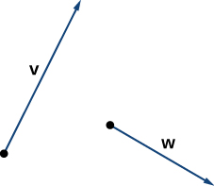
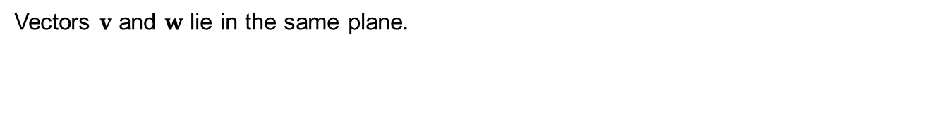
Figure 2.7
Vectors $v$ and $w$ lie in the same plane.

Slide 9
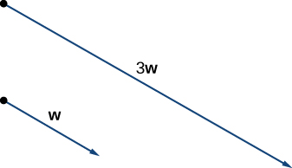

Slide 10
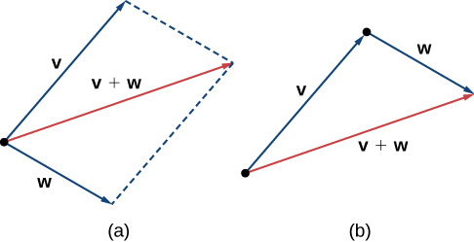
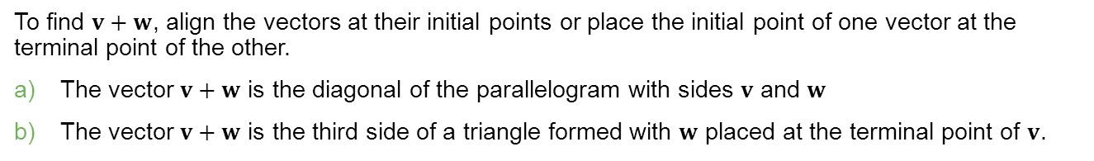
Figure 2.8
To find $v+w$, align the vectors at their initial points or place the initial point of one vector at the terminal point of the other.
The vector $v+w$ is the diagonal of the parallelogram with sides $v$ and $w$
The vector $v+w$ is the third side of a triangle formed with $w$ placed at the terminal point of $v$.

Slide 11
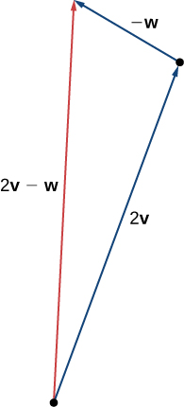
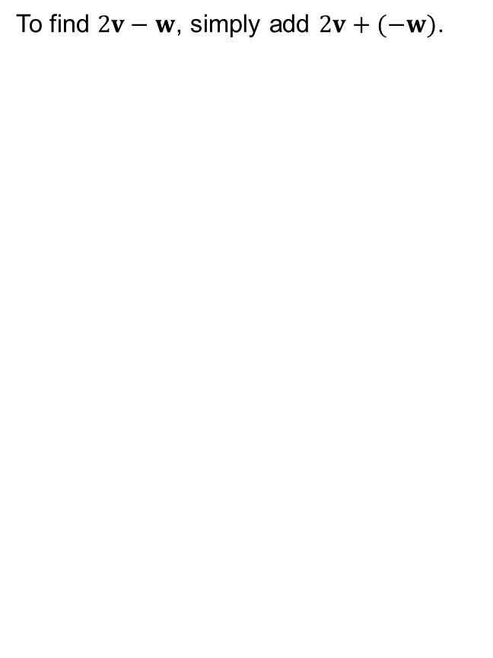
Figure 2.9
To find $2v−w$, simply add $2v+(−w)$.

Slide 12
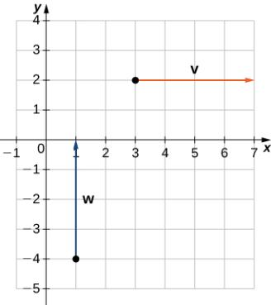
Figure 2.10
These vectors are not equivalent.

Slide 13
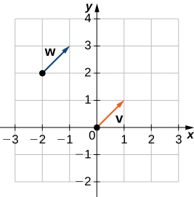
Figure 2.11
These vectors are equivalent.

Slide 14
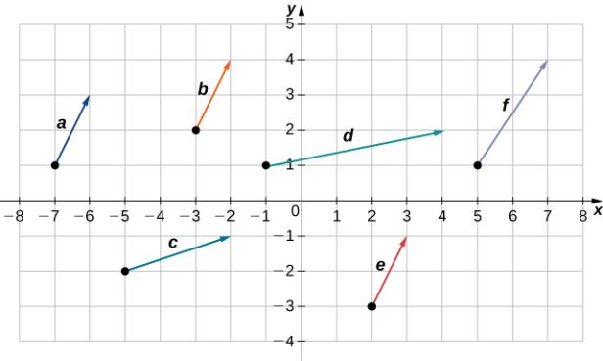

Slide 15
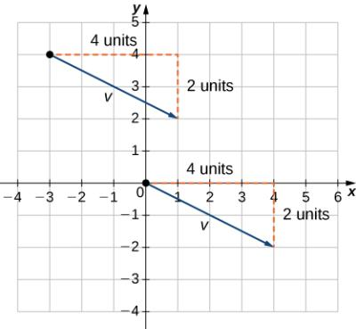
Figure 2.12
These vectors are equivalent.

Slide 16
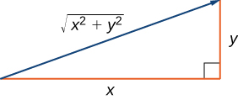
Figure 2.13
If you use the components of a vector to define a right triangle, the magnitude of the vector is the length of the triangle’s hypotenuse.

Slide 17
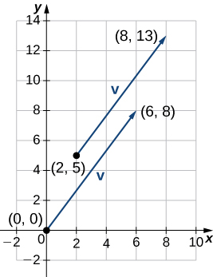
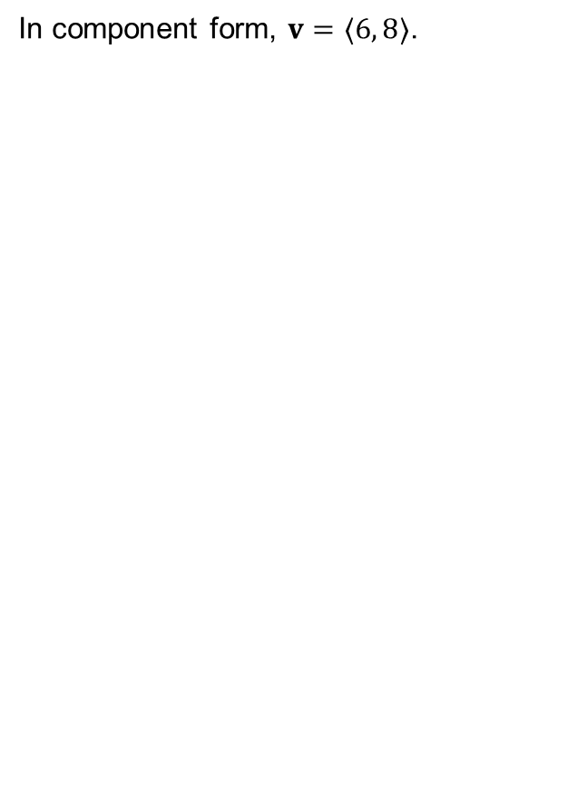
Figure 2.14
In component form, $v=〈6, 8〉$.

Slide 18
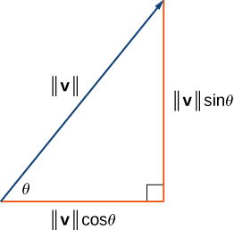
Figure 2.15
The components of a vector form the legs of a right triangle, with the vector as the hypotenuse.

Slide 19
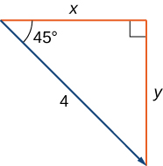
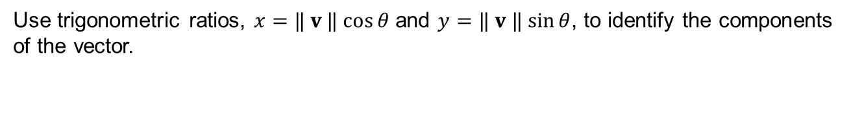
Figure 2.16
Use trigonometric ratios, $x=‖ v ‖ cos⁡θ$ and $y=‖ v ‖ sin⁡θ$, to identify the components of the vector.

Slide 20
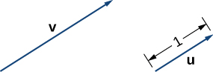
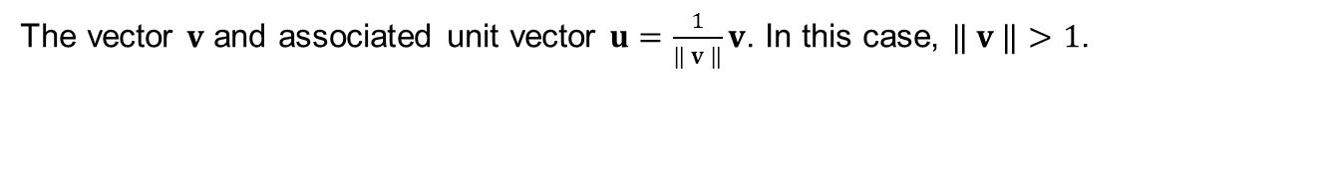
Figure 2.17
The vector $v$ and associated unit vector $u=\frac{1}{‖ v ‖}v$. In this case, $‖ v ‖>1$.

Slide 21
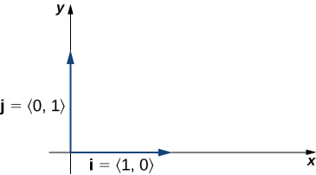

Figure 2.18
The standard unit vectors $i$ and $j$.

Slide 22
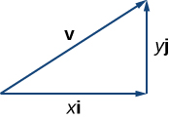
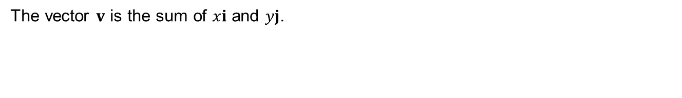
Figure 2.19
The vector $v$ is the sum of $xi$ and $yj$.

Slide 23
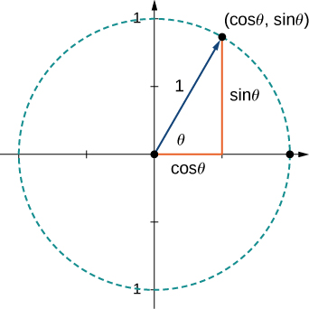

Figure 2.20
The terminal point of $u$ lies on the unit circle $(cos⁡θ, sin⁡θ)$.

Slide 24
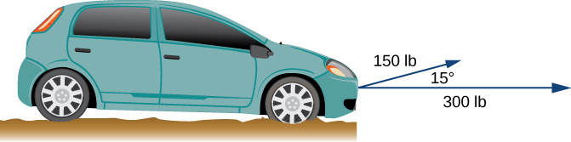
Figure 2.21
Two forces acting on a car in different directions.

Slide 25
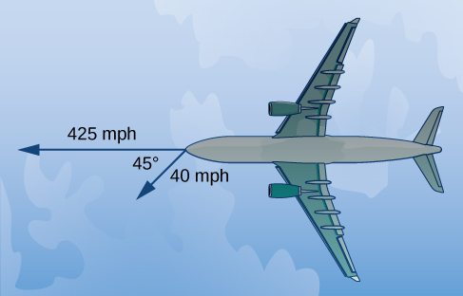
Figure 2.22
Initially, the plane travels due west. The wind is from the northeast, so it is blowing to the southwest. The angle between the plane’s course and the wind is 45°. (Figure not drawn to scale.)

Slide 26
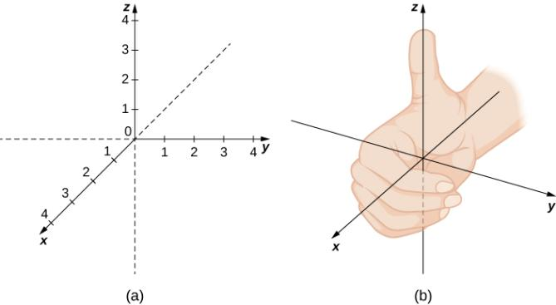
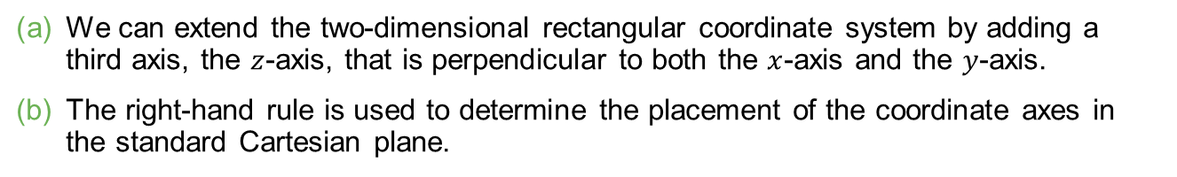
Figure 2.23
We can extend the two-dimensional rectangular coordinate system by adding a third axis, the $z$-axis, that is perpendicular to both the $x$-axis and the $y$-axis.
The right-hand rule is used to determine the placement of the coordinate axes in the standard Cartesian plane.

Slide 27
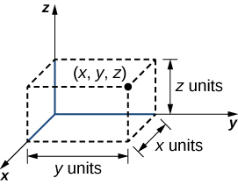
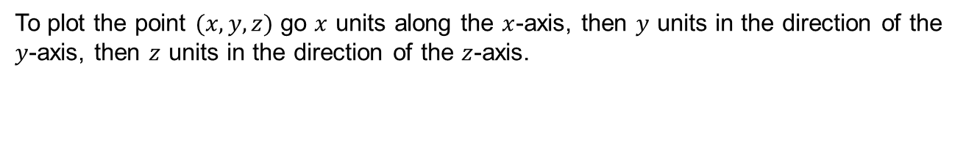
Figure 2.24
To plot the point $(x, y, z)$ go $x$ units along the $x$-axis, then $y$ units in the direction of the $y$-axis, then $z$ units in the direction of the $z$-axis.

Slide 28
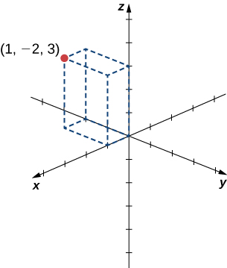
Figure 2.25
Sketching the point (1, −2, 3).

Slide 29
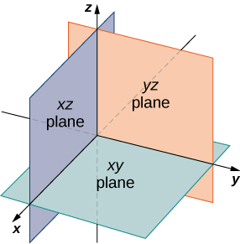
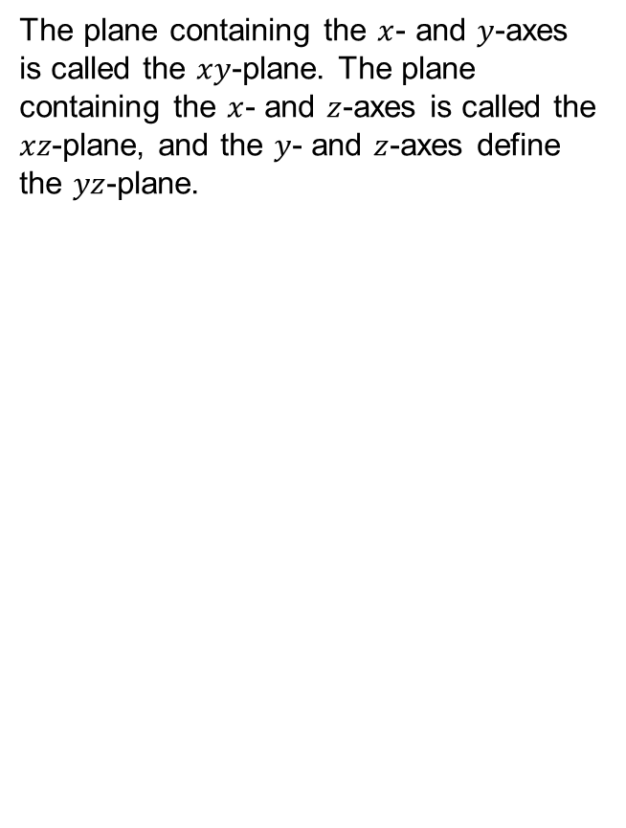
Figure 2.26
The plane containing the $x$- and $y$-axes is called the $xy$-plane. The plane containing the $x$- and $z$-axes is called the $xz$-plane, and the $y$- and $z$-axes define the $yz$-plane.

Slide 30
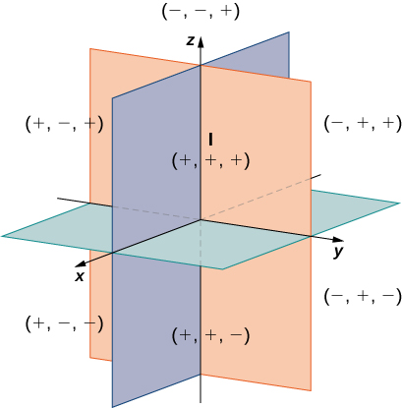
Figure 2.27
Points that lie in octants have three positive coordinates.

Slide 31
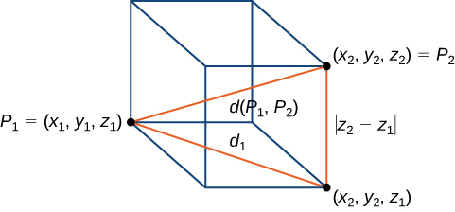
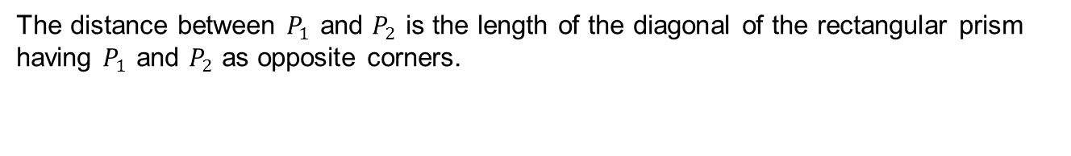
Figure 2.28
The distance between $P_{1}$ and $P_{2}$ is the length of the diagonal of the rectangular prism having $P_{1}$ and $P_{2}$ as opposite corners.

Slide 32
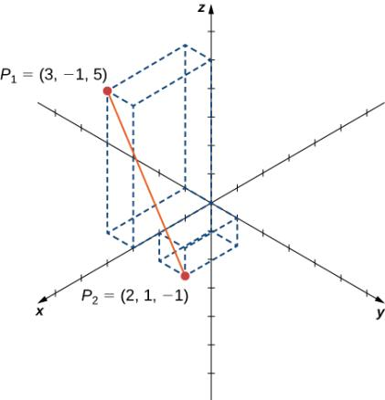
Figure 2.29
Find the distance between the two points.

Slide 33
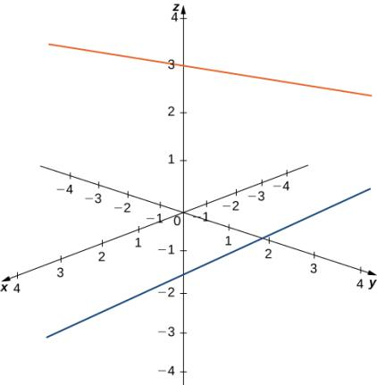
Figure 2.30
These two lines are not parallel, but still do not intersect.

Slide 34
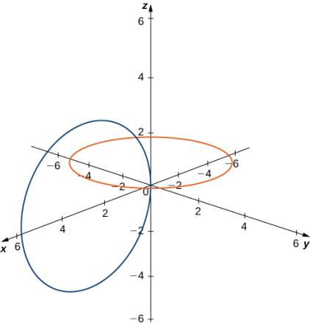
Figure 2.31
These circles are interconnected, but have no points in common.

Slide 35


Figure 2.32
In $ℝ$, the equation $x=0$ describes a single point.
In $ℝ^{2}$, the equation $x=0$ describes a line, the $y$-axis.
In $ℝ^{3}$, the equation $x=0$ describes a plane, the $yz$-plane.

Slide 36


Figure 2.33
In space, the equation $z=0$ describes the $xy$-plane.
All points in the $xz$-plane satisfy the equation $y=0$.

Slide 37


Figure 2.34
Each point $(x, y, z)$ on the surface of a sphere is $r$ units away from the center $(a, b, c)$.

Slide 38

Figure 2.35
The sphere centered at (10, 7, 4) containing point (−1, 3, −2).

Slide 39


Figure 2.36
Line segment $PQ$.

Slide 40


Figure 2.37
The set of points satisfying $(x−4)(z−2)=0$ forms the two planes $x=4$ and $z=2$.

Slide 41


Figure 2.38
The set of points satisfying ${(x−2)}^{2}+{(y−1)}^{2 }=4$. This is a cylinder of radius 2 centered on the line with $x=2$ and $y=1$.

Slide 42


Figure 2.39
Vector $v=〈 2, 4, 1〉$ is represented by a directed line segment from point (0, 0, 0) to point (2, 4, 1).

Slide 43


Figure 2.40
The vector with initial point $P=(3, 12, 6)$ and terminal point $Q=(–4, –3, 2)$.

Slide 44

Figure 2.41
To add vectors in three dimensions, we follow the same procedures we learned for two dimensions.

Slide 45


Figure 2.42
The vectors $v=〈−2, 9, 5〉$ and $w=〈1, −1, 0〉$.

Slide 46


Slide 47


Slide 48

Figure 2.43
(credit: modification of work by Kenneth Lu, Flickr)

Slide 49


Figure 2.44
Let $θ$ be the angle between two nonzero vectors $u$ and $v$ such that $0≤θ≤π$.

Slide 50

Figure 2.45
The lengths of the sides of the triangle are given by the magnitudes of the vectors that form the triangle.

Slide 51


Figure 2.46
An acute angle has $0<cos⁡θ<1$.
An obtuse angle has $−1<cos⁡θ<0$.
A straight line has $cos⁡θ=−1$.
If the vectors have the same direction, $cos⁡θ=1$.
If the vectors are orthogonal (perpendicular), $cos⁡θ=0$.

Slide 52


Figure 2.47
Vectors $p$ and $q$ form a right angle when their initial points are aligned.

Slide 53


Figure 2.48
Angle $α$ is formed by vector $v$ and unit vector $i$. Angle $β$ is formed by vector $v$ and unit vector $j$. Angle $γ$ is formed by vector $v$ and unit vector $k$.

Slide 54

Figure 2.49
When a child pulls a wagon, only the horizontal component of the force propels the wagon forward.

Slide 55


Figure 2.50
The projection of $v$ onto $u$ shows the component of vector $v$ in the direction of $u$.

Slide 56


Slide 57


Slide 58


Figure 2.51
The horizontal component of the force is the projection of $F$ onto the positive $x$-axis.

Slide 59

Figure 2.52

Slide 60

Figure 2.53
Finding a cross product to two given vectors.

Slide 61


Figure 2.54
The direction of $u×v$ is determined by the right-hand rule.

Slide 62


Figure 2.55
Are the cross products $u×v$ and $v×u$ in the same direction?

Slide 63


Figure 2.56
The cross products $u×v$ and $v×u$ are both orthogonal to $u$ and $v$, but in opposite directions.

Slide 64


Figure 2.57
The parallelogram with adjacent sides $u$ and $v$ has base $‖ u ‖$ and height $\left\| v \right\| sin⁡θ$.

Slide 65

Figure 2.58
Finding the area of a triangle by using the cross product.

Slide 66


Figure 2.59
The height of the parallelepiped is given by $‖ {proj}_{v×w} u ‖$.

Slide 67

Figure 2.60

Slide 68

Figure 2.61
Torque measures how a force causes an object to rotate.

Slide 69

Figure 2.62
Torque describes the twisting action of the wrench.

Slide 70


Figure 2.63
Vector $v$ is the direction vector for $\vec{PQ}$.

Slide 71


Figure 2.64
The distance from point $M$ to line $L$ is the length of $\overline{MP}$.

Slide 72


Figure 2.65
Vectors $\vec{PM}$ and $v$ form two sides of a parallelogram with base $‖ v ‖$ and height $d$, which is the distance between a line and a point in space.

Slide 73


Figure 2.66
Point (1, 1, 3) is approximately 2.7 units from the line with symmetric equations $\frac{x−3}{4}=\frac{y+1}{2} =z−3$.

Slide 74

Figure 2.67
In three dimensions, it is possible that two lines do not cross, even when they have different directions.

Slide 75

Figure 2.68
Determine the relationship between two lines based on whether their direction vectors are parallel and whether they share a point.

Slide 76


Slide 77


Slide 78


Slide 79


Figure 2.69
Given a point $P$ and vector $n$, the set of all points $Q$ with $\vec{PQ}$ orthogonal to $n$ forms a plane.

Slide 80


Slide 81


Figure 2.70
We want to find the shortest distance from point $P$ to the plane. Let point $R$ be the point in the plane such that, for any other point in the plane $Q$, $‖ \vec{RP} ‖<‖ \vec{QP} ‖$.

Slide 82


Slide 83

Figure 2.71
The intersection of two nonparallel planes is always a line.

Slide 84


Slide 85

Figure 2.72
The angle between two planes has the same measure as the angle between the normal vectors for the planes.

Slide 86

Figure 2.73
Industrial pipe installations often feature pipes running in different directions. How can we find the distance between two skew pipes?

Slide 87

Figure 2.74
Two pipes cross through a standard frame unit.

Slide 88


Figure 2.75
In three-dimensional space, the graph of equation $x^{2}+y^{2}=9$ is a cylinder with radius 3 centered on the $z$-axis. It continues indefinitely in the positive and negative directions.

Slide 89


Figure 2.76
In three-dimensional space, the graph of equation $z=x^{3}$ is a cylinder, or a cylindrical surface with rulings parallel to the $y$-axis.

Slide 90


Figure 2.77
The graph of equation $x^{2}+z^{2}=25$ is a cylinder with radius 5 centered on the $y$-axis.

Slide 91

Figure 2.78

Slide 92


Figure 2.79
The graph of equation $y=sin⁡x$ is formed by a set of lines parallel to the $z$-axis passing through curve $y=sin⁡x$ in the $xy$-plane.

Slide 93


Figure 2.80
This is one view of the graph of equation $z=sin⁡x$.
To find the trace of the graph in the $xz$-plane, set $y=0$. The trace is simply a two-dimensional sine wave.

Slide 94


Figure 2.81
This graph represents the trace of equation $\frac{x^{2}}{2^{2}}+\frac{y^{2}}{3^{2}}+\frac{z^{2}}{5^{2}}=1$ in the $xy$-plane, when we set $z=0$.
When we set $y=0$, we get the trace of the ellipsoid in the $xz$-plane, which is an ellipse.
When we set $x=0$, we get the trace of the ellipsoid in the $yz$-plane, which is also an ellipse.

Slide 95

Figure 2.82
The traces provide a framework for the surface.
The center of this ellipsoid is the origin.

Slide 96

Figure 2.83
This quadric surface is called an elliptic paraboloid.

Slide 97


Figure 2.84
The paraboloid $x^{2}+\frac{y^{2}}{2^{2}}=\frac{z}{5}$.
The trace in plane $z=5$.
The trace in the $xz$-plane.
The trace in the $yz$-plane.

Slide 98

Figure 2.85
A sculpture in the shape of a hyperboloid can be constructed of straight lines.
Cooling towers for nuclear power plants are often built in the shape of a hyperboloid.

Slide 99

Figure 2.86
Energy reflects off of the parabolic reflector and is collected at the focal point. (credit: modification of CGP Grey, Wikimedia Commons)

Slide 100

Figure 2.87
Characteristics of Common Quadratic Surfaces: Ellipsoid, Hyperboloid of One Sheet, Hyperboloid of Two Sheets.

Slide 101

Figure 2.88
Characteristics of Common Quadratic Surfaces: Elliptic Cone, Elliptic Paraboloid, Hyperbolic Paraboloid.

Slide 102


Figure 2.89
The right triangle lies in the $xy$-plane. The length of the hypotenuse is $r$ and $θ$ is the measure of the angle formed by the positive $x$-axis and the hypotenuse. The $z$-coordinate describes the location of the point above or below the $xy$-plane.

Slide 103


Figure 2.90
The Pythagorean theorem provides equation $r^{2}=x^{2}+y^{2}$. Right-triangle relationships tell us that $x=r cos⁡θ$, $y=r sin⁡θ$, and $tan⁡θ=y/x$.

Slide 104


Figure 2.91
In rectangular coordinates, (a) surfaces of the form $x=c$ are planes parallel to the $yz$-plane, (b) surfaces of the form $y=c$ are planes parallel to the $xz$-plane, and (c) surfaces of the form $z=c$ are planes parallel to the $xy$-plane.

Slide 105


Figure 2.92
In cylindrical coordinates, (a) surfaces of the form $r=c$ are vertical cylinders of radius $r$, (b) surfaces of the form $θ=c$ are half-planes at angle $θ$ from the $x$-axis, and (c) surfaces of the form $z=c$ are planes parallel to the $xy$-plane.

Slide 106


Figure 2.93
The projection of the point in the $xy$-plane is 4 units from the origin. The line from the origin to the point’s projection forms an angle of $\frac{2π}{3}$ with the positive $x$-axis. The point lies 2 units below the $xy$-plane.

Slide 107


Figure 2.94
In polar coordinates, the equation $θ=π/4$ describes the ray extending diagonally through the first quadrant. In three dimensions, this same equation describes a half-plane.

Slide 108


Figure 2.95
The sphere centered at the origin with radius 3 can be described by the cylindrical equation $r^{2}+z^{2}=9$.

Slide 109


Figure 2.96
The traces in planes parallel to the $xy$-plane are circles. The radius of the circles increases as $z$ increases.

Slide 110

Figure 2.97
The relationship among spherical, rectangular, and cylindrical coordinates.

Slide 111

Figure 2.98
The equations that convert from one system to another are derived from right-triangle relationships.

Slide 112


Figure 2.99
In spherical coordinates, surfaces of the form $ρ=c$ are spheres of radius $ρ$ (a), surfaces of the form $θ=c$ are half-planes at an angle $θ$ from the $x$-axis (b), and surfaces of the form $φ=c$ are half-cones at an angle $φ$ from the $z$-axis (c).

Slide 113


Figure 2.100
The projection of the point in the $xy$-plane is 4 units from the origin. The line from the origin to the point’s projection forms an angle of $π/3$ with the positive $x$-axis. The point lies $4\sqrt{3}$ units above the $xy$-plane.

Slide 114


Figure 2.101
The surface described by equation $θ=\frac{π}{3}$ is a half-plane.

Slide 115


Figure 2.102
The equation $φ=\frac{5π}{6}$ describes a cone.

Slide 116


Figure 2.103
Equation $ρ=6$ describes a sphere with radius 6.

Slide 117

Figure 2.104
In the latitude–longitude system, angles describe the location of a point on Earth relative to the equator and the prime meridian.

Slide 118

Figure 2.105
(credit: (a) modification of work by scl hua, Wikimedia, (b) modification of work by DVIDSHUB, Flickr, (c) modification of work by Michael Malak, Wikimedia, (d) modification of work by Sean Mack, Wikimedia, (e) modification of work by Elvert Barnes, Flickr)

Slide 119


Slide 120
This OpenStax ancillary resource is © Rice University under a CC BY-NC-SA 4.0 International license; it may be reproduced or modified for noncommercial purposes only but must be attributed to OpenStax, Rice University and any changes must be noted. Any adaptation must be shared under the same type of license.

